Slide 1
Portafolio
Creative Process
By Cinthya Cabanzo

Slide 2
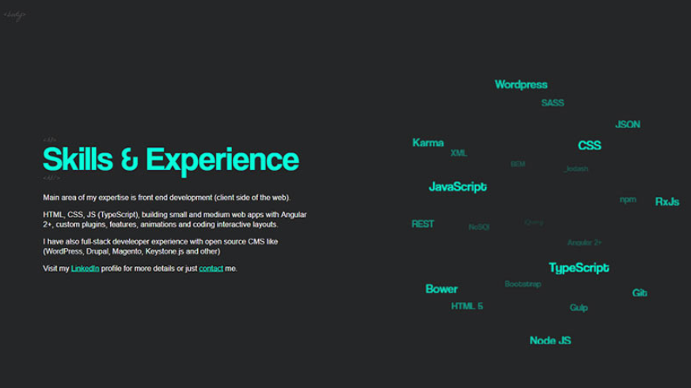


Slide 3
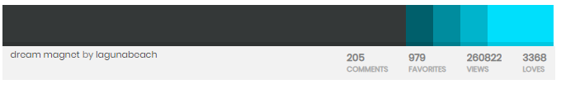
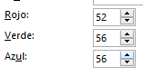
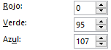
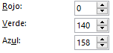
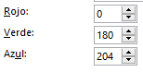
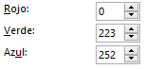
Paleta
#343838
#005F6B
#008C9E
#00B4CC
#00E9FC

Slide 4

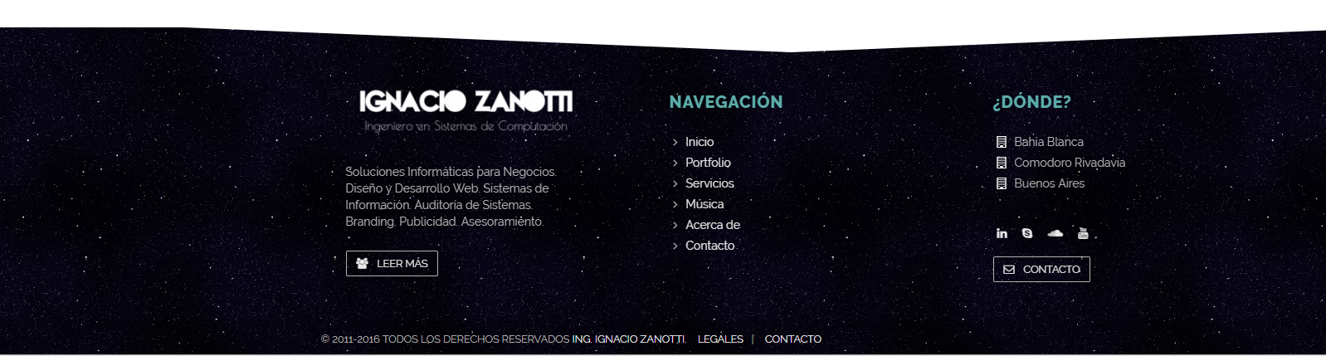
Footer
Notes:
https://www.w3schools.com/css/css3_buttons.asp
<style>
.button2:hover {
box-shadow: 0 8px 16px 0 rgba(0,0,0,0.24),0 17px 50px 0 rgba(0,0,0,0.19);
}
</style>

Slide 5
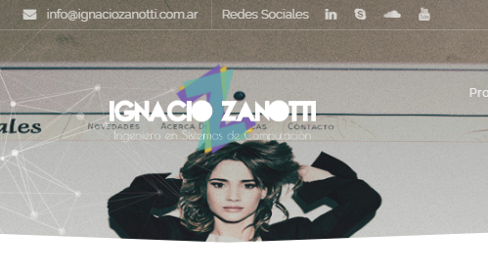
Banner Dinamico
Notes:
http://www.ignaciozanotti.com.ar/tributoweb

Slide 6

Iconos
Notes:
<div>Icons made by <a href="https://www.freepik.com/?__hstc=57440181.dd2f7117b66840b57fe64a259c87dc7b.1561213190986.1561213190986.1561213190986.1&__hssc=57440181.3.1561213190987&__hsfp=4222521352" title="Freepik">Freepik</a> from <a href="https://www.flaticon.com/" title="Flaticon">www.flaticon.com</a> is licensed by <a href="http://creativecommons.org/licenses/by/3.0/" title="Creative Commons BY 3.0" target="_blank">CC 3.0 BY</a></div>

Slide 7
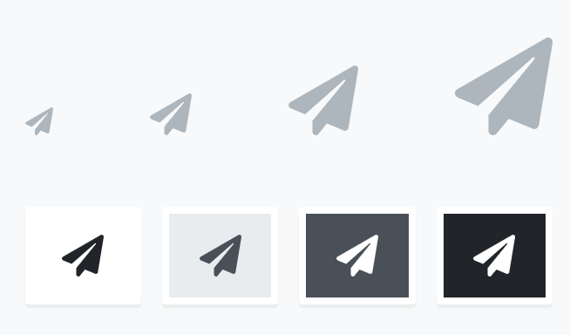
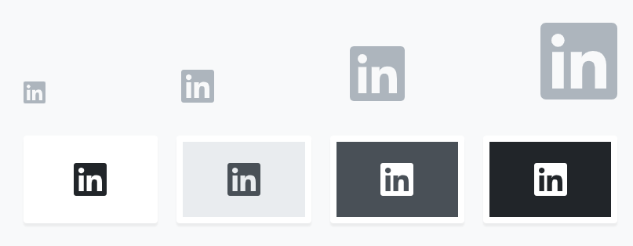
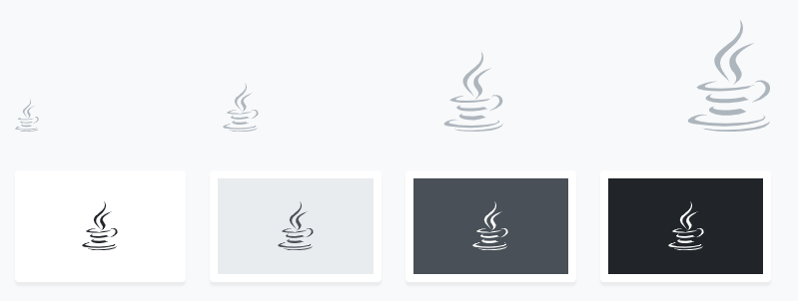
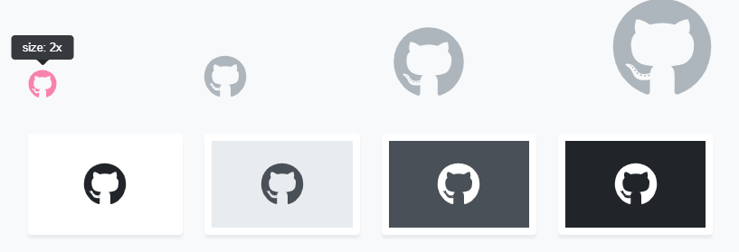
Iconos
https://fontawesome.com/
<i class="fab fa-github"></i>
<i class="fab fa-java"></i>
<i class="fab fa-linkedin"></i>
<i class="fas fa-paper-plane"></i>
<i class="fab fa-html5"></i>
<i class="fab fa-css3-alt"></i>
<i class="fas fa-copy"></i>
<i class="fas fa-lightbulb"></i>

Slide 8
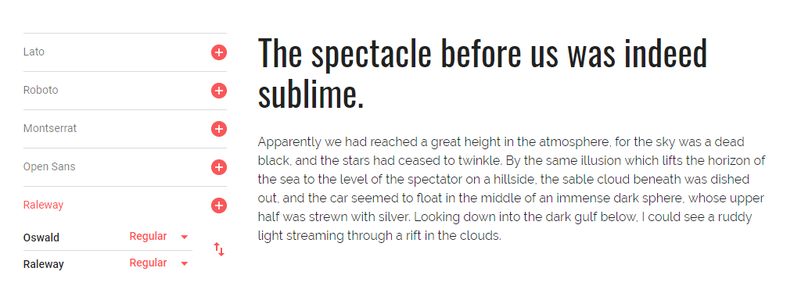
Fuentes
Notes:
https://developers.google.com/fonts/docs/getting_started
<style> @import url('https://fonts.googleapis.com/css?family=Oswald:200,300,400,500,600,700|Raleway:100,100i,200,200i,300,300i,400,400i,500,500i,600,600i,700,700i,800,800i,900,900i&display=swap'); </style>
<link href="https://fonts.googleapis.com/css?family=Oswald:200,300,400,500,600,700|Raleway:100,100i,200,200i,300,300i,400,400i,500,500i,600,600i,700,700i,800,800i,900,900i&display=swap" rel="stylesheet">
font-family: 'Oswald', sans-serif;
font-family: 'Raleway', sans-serif;

Slide 9
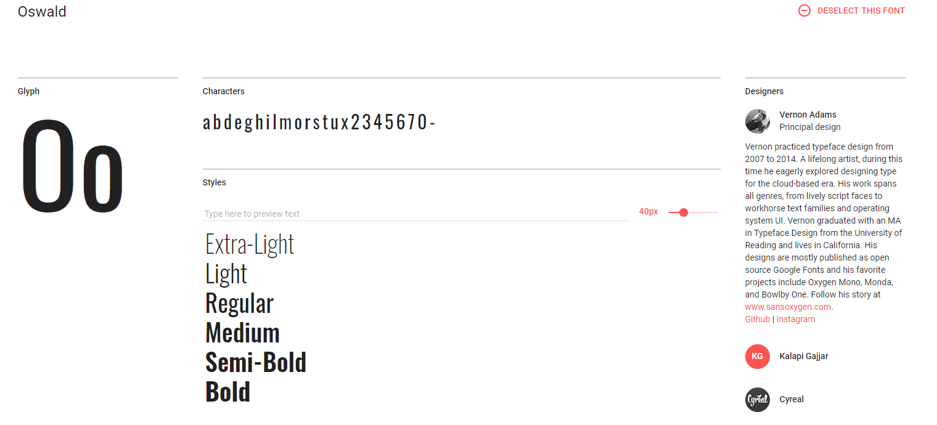
Oswald
<style> @import url('https://fonts.googleapis.com/css?family=Oswald:200,300,400,500,600,700&display=swap'); </style>
font-family: 'Oswald', sans-serif;

Slide 10
Oswald

Slide 11
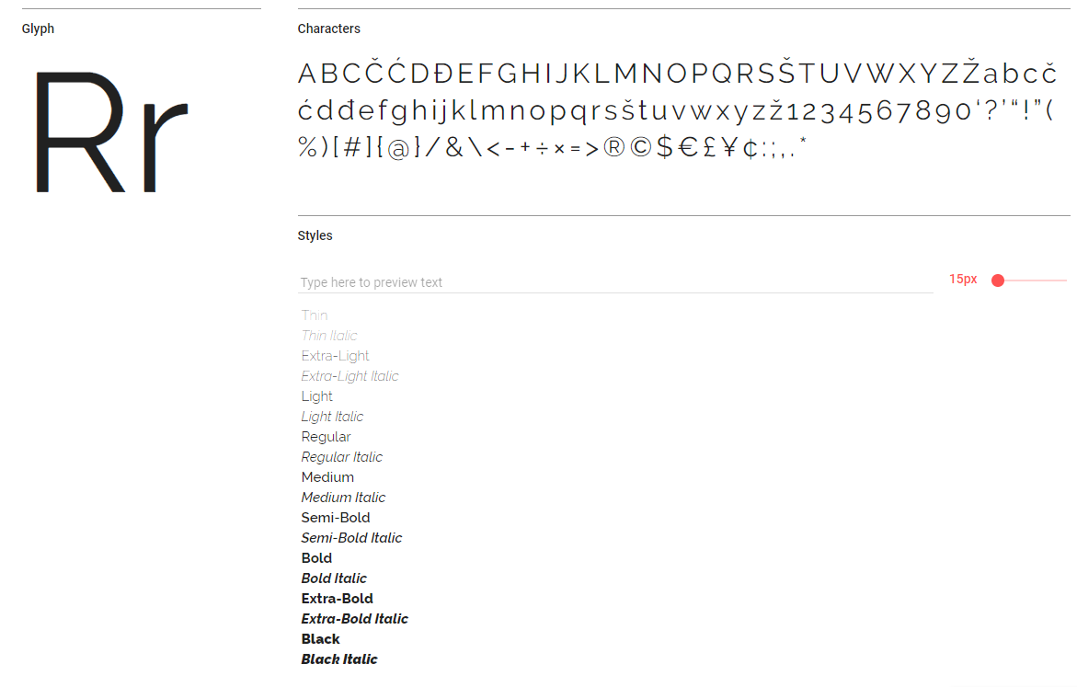
Raleway

Slide 12
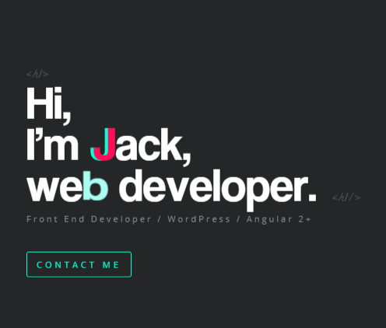
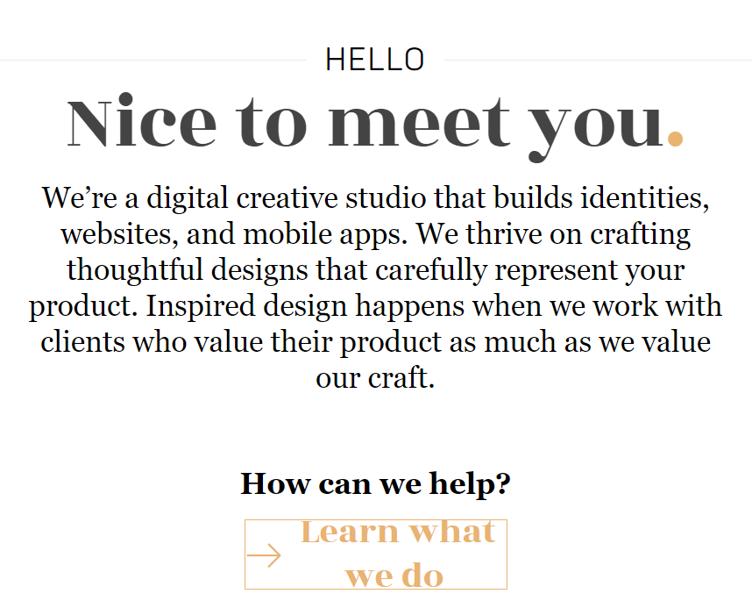
Cinthya Cabanzo
Notes:
HELLO
Nice to meet you.
We’re a digital creative studio that builds identities, websites, and mobile apps. We thrive on crafting thoughtful designs that carefully represent your product. Inspired design happens when we work with clients who value their product as much as we value our craft.

Slide 13
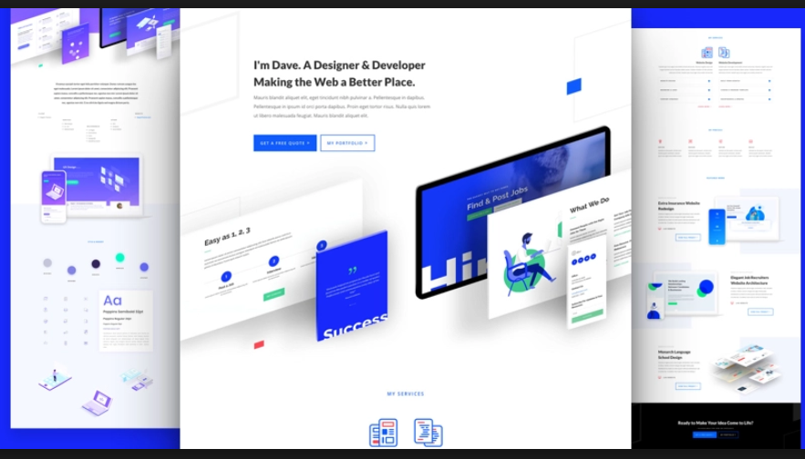
Portafolio

Slide 14
Skills
Notes:
https://jacekjeznach.com/
Identity Design
Web Development
Interface Design

Slide 15
Contacto

Slide 16

Notes:
Photo by Jean-Philippe Delberghe on Unsplash

Slide 17
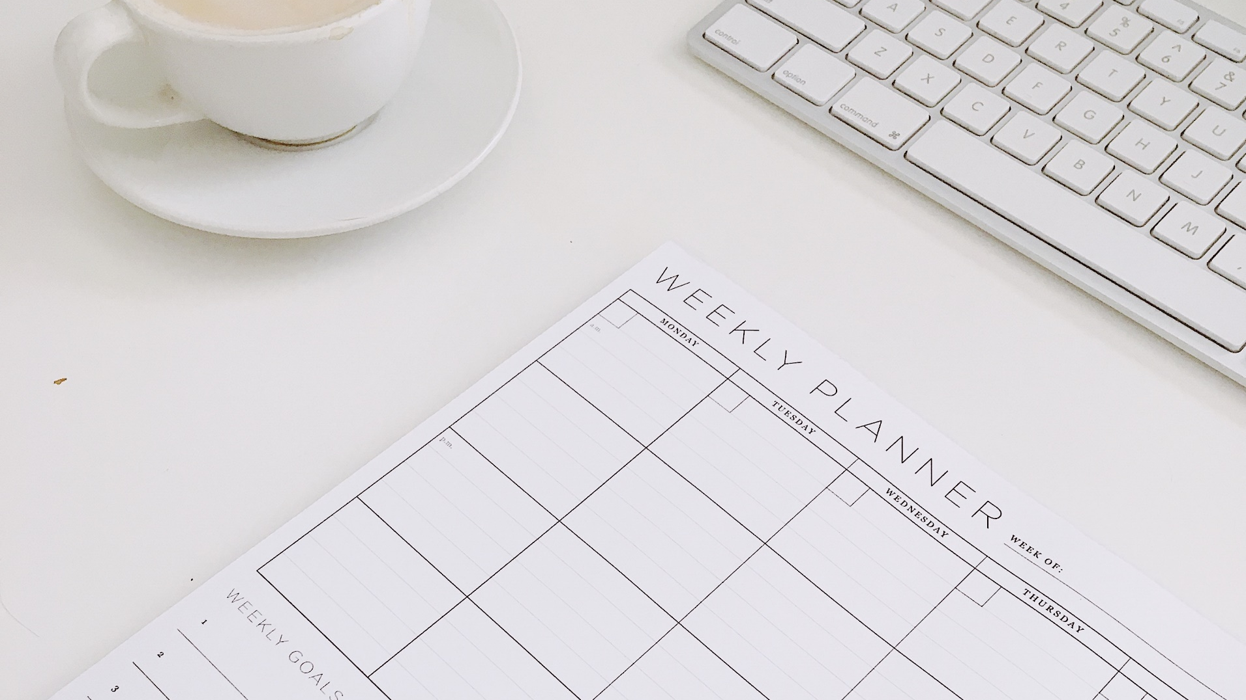
Notes:
Photo by Nikiya Christie on Unsplash

Slide 18

Notes:
Photo by Ellen Qin on Unsplash

Slide 19
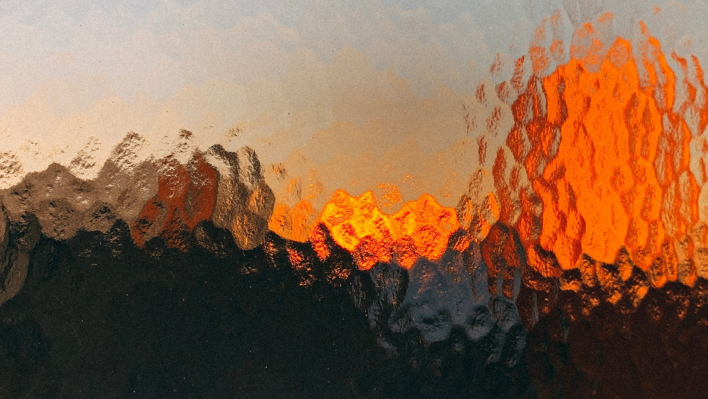
Notes:
Photo by Jonas Denil on Unsplash

Slide 20
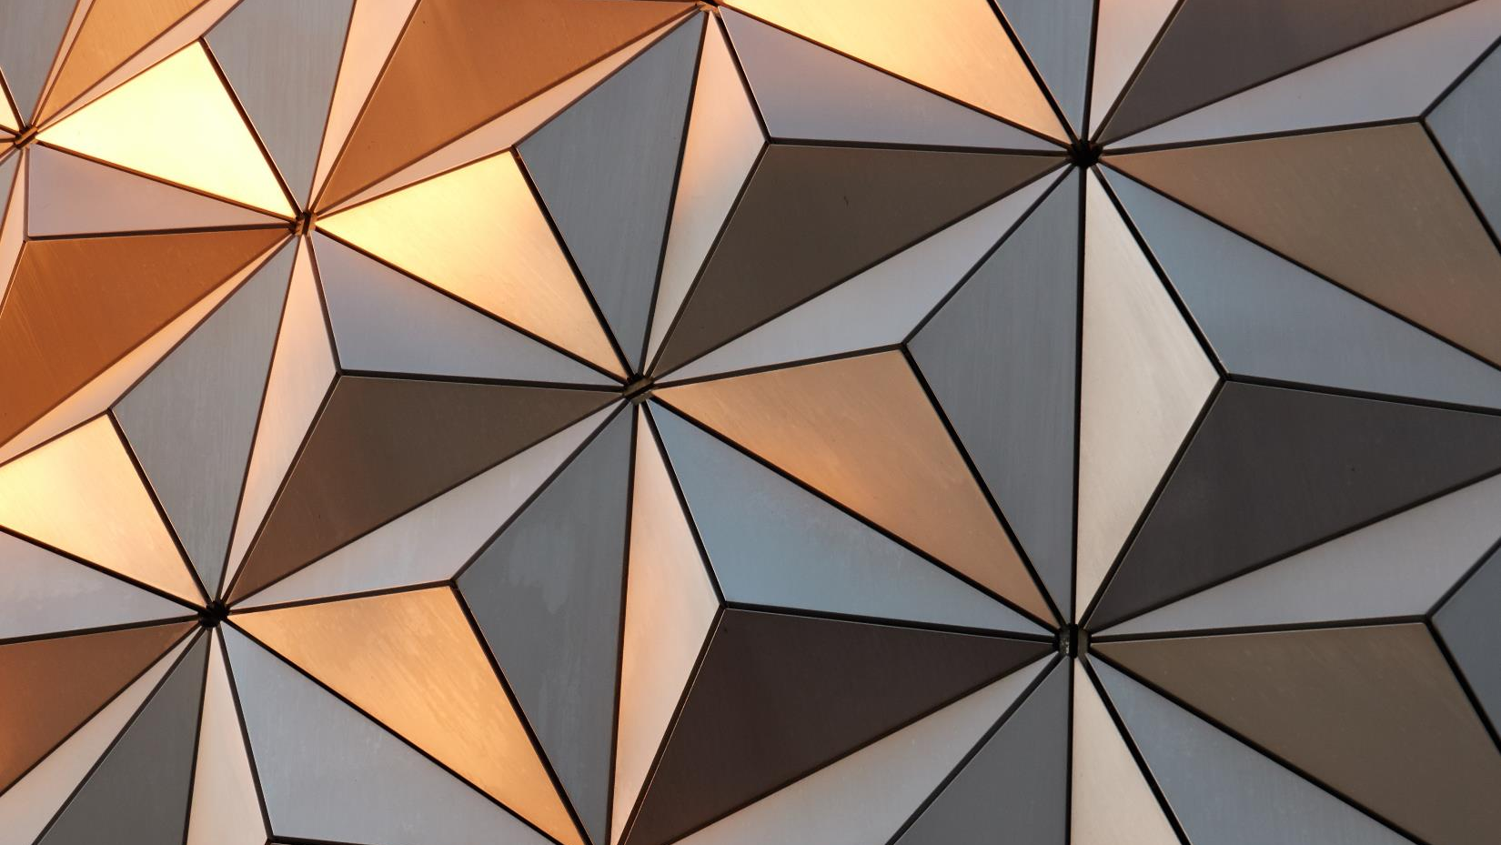

Slide 21

CINTHYA CABANZO
PORTAFOLIO
SKILLS
CONTACTO
Notes:
Photo by Anas Alshanti on Unsplash

Slide 22
CINTHYA CABANZO
PORTAFOLIO
SKILLS
CONTACTO
Notes:
Photo by Anas Alshanti on Unsplash

Slide 23

CINTHYA CABANZO
PORTAFOLIO
SKILLS
CONTACTO
Notes:
Photo by Anas Alshanti on Unsplash

Slide 24

CINTHYA CABANZO
PORTAFOLIO
SKILLS
CONTACTO
Notes:
Photo by Sharon McCutcheon on Unsplash

Slide 25
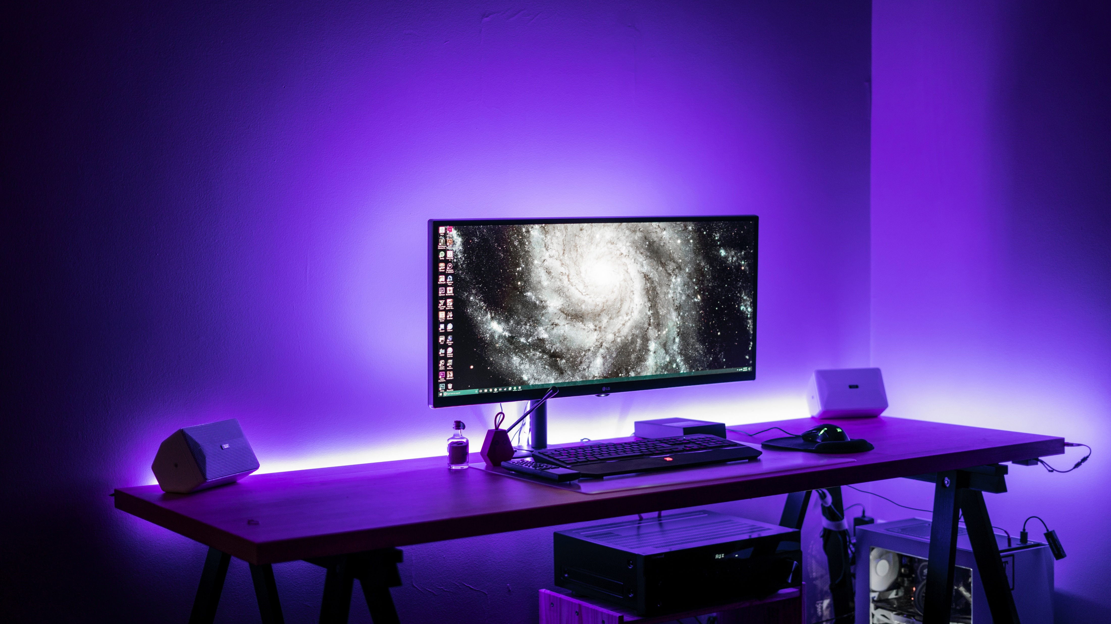
CINTHYA CABANZO
PORTAFOLIO
SKILLS
CONTACTO
Notes:
Photo by Banter Snaps on Unsplash

Slide 26
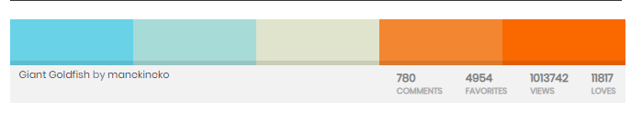
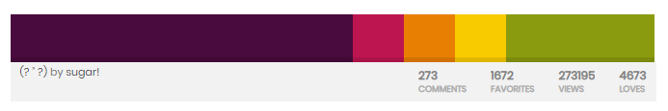
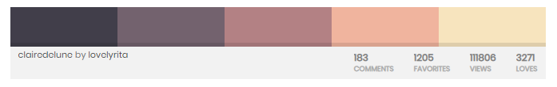
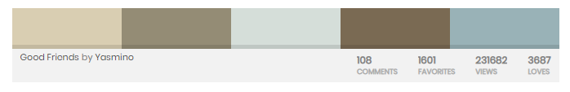
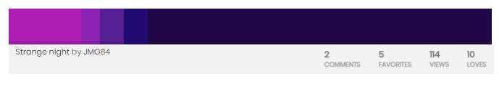
Paletas de colores

Slide 27
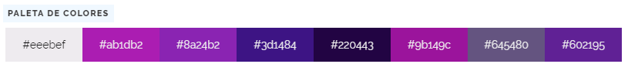
Notes:
#eeebef
#ab1db2
#8a24b2
#3d1484
#220443
#9b149c
#645480
#602195

Slide 28
Referentes
https://jacekjeznach.com/
Diseño en una sola pagina:
https://www.v76.com/
Iconos flotantes y menú escondido tipo mobile
http://brianhoffdesign.com/#/work/markerly
Objetos 3d con movimiento y el cursor se transforma en un botón de play
https://locomotive.ca/en/projects/spire

Slide 29


Slide 30
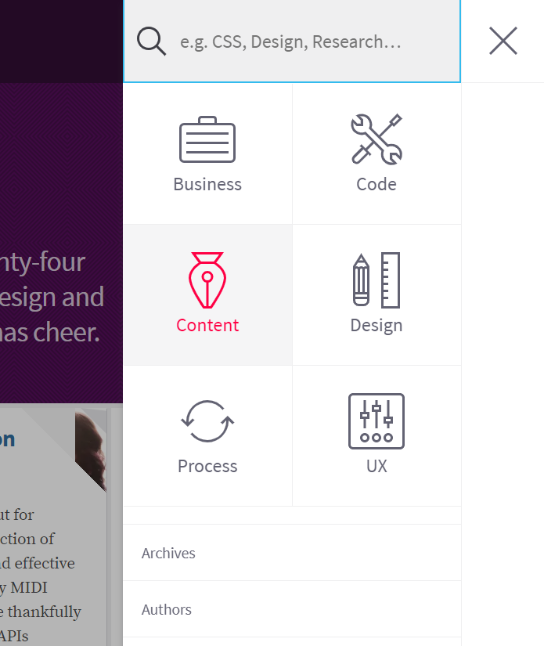
Menu Escondido

